Slide 1


AUXILIARY & SULPHURIC ACID PLANT
MSFE HEATER CLEANING PROCESS
DEV SATISH
2023B1A40833P

Slide 2
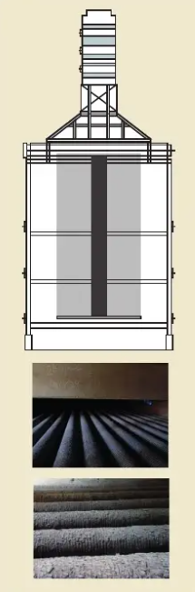
MSFE HEATER - STRUCTURE & PURPOSE
The heater unit used in a Multiple-Effect Evaporator (MSFE) system. It is essentially a shell-and-tube heat exchanger used to heat the feed liquid before it enters each evaporator effect.
Purpose of an MSFE Heater:
An MSFE system uses steam to evaporate water or solvent from a feed liquid in multiple stages ("effects") to increase energy efficiency. The MSFE Heater plays a crucial role in this process.
  Heats Feed Liquid:
    Steam is passed through the shell side of the heater.
    The feed liquid passes through the tube side.
    Heat is transferred from the steam to the liquid.
  Prepares for Evaporation:
    The heated liquid is then sent to the evaporator body, where it boils under vacuum, separating water as vapor.
    Heating is done just below the boiling point at reduced pressure, minimizing energy use.
  Repeats Across Effects:
    In later effects, vapor from the previous stage is reused as the heating medium, and a new heater is used in each stage.
At Grasim Industries, especially in VSF and chemical recovery, MSFE heaters:
  Concentrate chemical effluents or weak acid streams
  Improve steam economy (reduce fresh steam use)
  Handle high-TDS, corrosive feed liquids, requiring durable materials (titanium)
  Are critical in minimizing wastewater volume and energy consumption
Control Measures adopted MSFE RO feed increased for more water recycling
> Water saving of 600 m3/day
Why is Cleaning Important?
Because the feed liquid can cause scaling and fouling inside the tubes, reducing heat transfer. That’s why your project on Advancements in MSFE Heater Cleaning is important—it focuses on making cleaning faster, safer, and more efficient.
Ash and unburned hydrocarbons depostied in heaters convection tubes disturb effective heat transfer

Slide 3
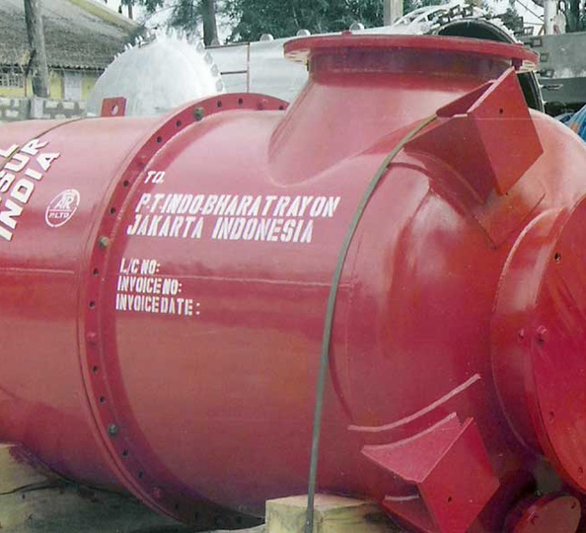
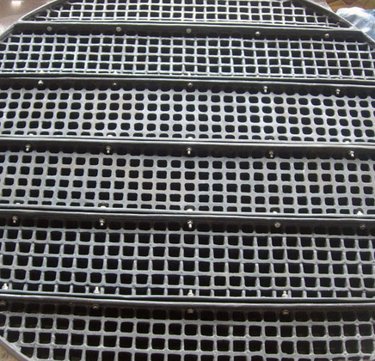
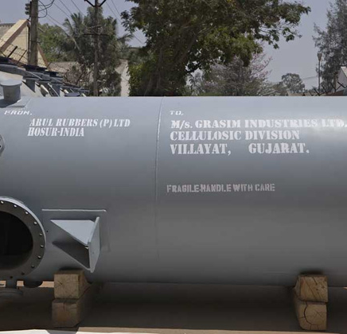
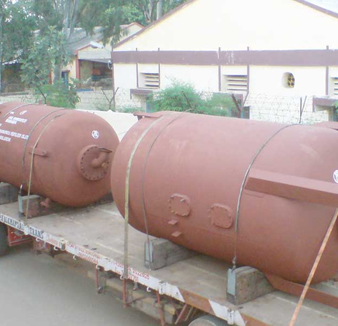
MSFE PROJECT EQUIPMENT & PRODUCTS
Tube Holder Plates
  Function: These plates hold and align the tubes inside the heater shell.
  Use in MSFE: In shell-and-tube heat exchangers, they ensure that heat transfer tubes are securely positioned, allowing efficient steam heating of the feed solution.
  Material: Usually made of corrosion-resistant metals (e.g., SS 316) to withstand hot, corrosive liquids.
Heater Shells and Evaporators
  Function: The heart of MSFE, where feed liquid is heated to cause evaporation.
  Heater Shells: Outer shell where steam is passed to heat the liquid inside tubes.
  Evaporators: Remove water from the feed by boiling it under vacuum, across multiple stages (effects), increasing steam efficiency.
  Material: Built to withstand thermal stress and corrosive environments.
Sand filter
  Function: Used for pre-treatment of feedwater or process liquid.
  Use in MSFE: Removes suspended solids that could cause scaling or fouling inside heater tubes and evaporators.
  Layers: Typically consist of sand, gravel, and pebbles to trap particles.
CYCLONE SEPERATOR
  Function: Use centrifugal force to separate vapors from entrained liquid droplets.
  Use in MSFE: After evaporation, these remove any liquid carryover from the vapor stream, ensuring dry steam moves to the next effect or for condensation.
  Efficiency: Prevents loss of product and scaling in downstream equipment.
GRID PLATES
HEATER SHELL
SAND FILTERS

Slide 4
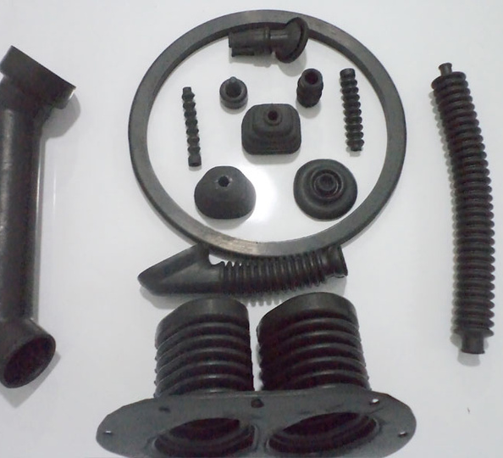
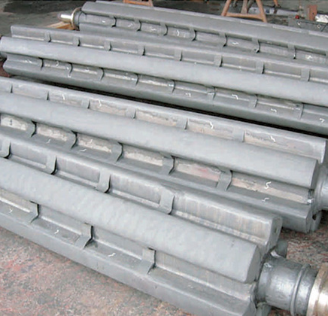
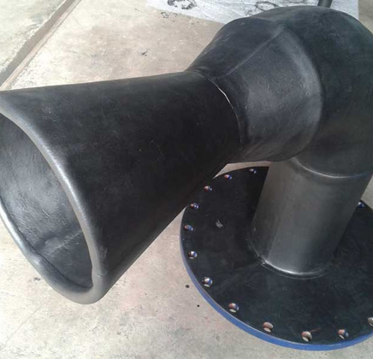
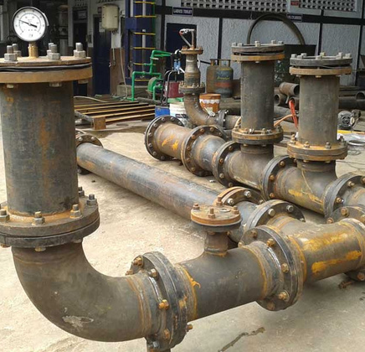
MSFE PROJECT EQUIPMENT & PRODUCTS
Star Rollers
  Function: Typically part of a scraper or rotating drum mechanism.
  Use in MSFE: Helps in concentrated slurry handling or crystal discharge from final effects.
  Design: Star-like rotating components to push solids/slurry and prevent blockages.
Intel & Flash Nozzles
  Inlet (Intel) Nozzles: Introduce feed liquid into the evaporator at specific locations to maximize surface contact.
  Flash Nozzles: Inject partially heated feed into a lower pressure effect, causing flash evaporation.
  Goal: Improve phase change efficiency and reduce scaling by directing flow smartly.
Pipes & Fittings
  Function: Carry steam, condensate, feed liquid, and vapor between various components.
  Types: Includes elbows, tees, reducers, valves, etc.
  Material: Must be resistant to corrosion, pressure, and temperature changes (e.g., SS 304, SS 316, FRP-lined pipes).
GASKETS
  Function: Ensure leak-proof sealing between flanged connections, covers, and joints.
  Use in MSFE: Maintain vacuum integrity and steam-tight seals in heaters and separators.
  Materials: Often made from EPDM, Viton, or PTFE, selected based on chemical compatibility
STAR ROLLERS
FLASH NOZZLE
PIPES AND FITTINGS

Slide 5
RESEARCH PAPER 1
Aim :
Cleaning Heater Convection Tubes
Background :
Fired heaters are critical in refineries, but over time, ash, unburned hydrocarbons, and foreign matter build up on the convection tubes, reducing heat transfer. The convection section is difficult to clean due to tight spacing, tube arrangement, and access issues. Liquid fuels cause more deposits than gas fuels, increasing the fouling risk.
Problems :
Narrow gaps between tubes (as little as 30 mm) make mechanical cleaning very hard. Tube bundles are long (>2 m), and some areas are inaccessible by hand.
Earlier methods involved spraying water and chemicals, which were ineffective for hard-to-reach areas or stubborn deposits.
Ash and unburned hydrocarbons depostied in heaters convection tubes disturb effective heat transfer

Slide 6
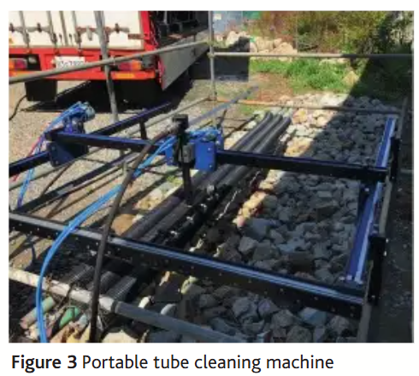
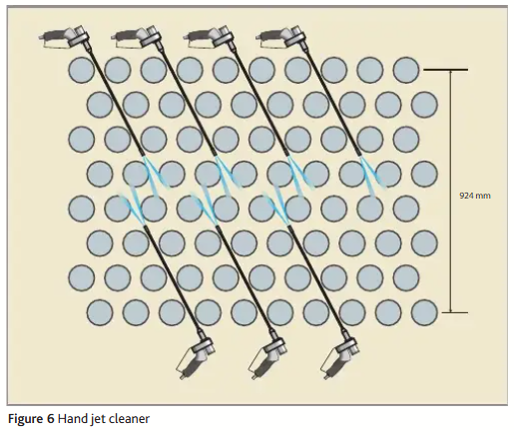
RESEARCH PAPER 1 - ADVANCEMENTS
Advancements in Fired Heater Cleaning Techniques
1. Portable Cleaning Machines : Automated machines with multi-directional rails and high-pressure jets (100 bar) clean large tube surfaces efficiently without scaffolding, reducing manual effort and hazards.
2. Hand Jet Cleaning : Ultra-high-pressure (2700 bar) water jets with flexible nozzles are manually inserted to reach tightly packed or deep tube areas, ensuring thorough cleaning where machines can't reach.
3. Chemical Cleaning Integration : A combination of chemicals is used to dissolve hard deposits and enhance cleaning efficiency :
Hydrochloric Acid (1–2%) – removes scale and oxides.
Ammonium Bifluoride – for silica-based or stubborn deposits.
Surfactants/Detergents – emulsify hydrocarbons and improve cleaning of oily
surfaces.
Corrosion Inhibitors (e.g., PDTDC) – protect metal surfaces during acid
exposure.
Neutralizers (e.g., Sodium Carbonate) – stop acid reaction after cleaning.
Passivators (e.g., Citric or Nitric Acid) – restore protective oxide layer on metal.
4. Endoscopic Inspection : Industrial cameras are used before and after cleaning to verify effectiveness and guide re-cleaning if needed..
5. Water Quality Monitoring : Cleaning progress is tracked by observing water clarity (dirty to clear), helping avoid under- or over-cleaning.
6. Optimized Cleaning Sequence : A defined sequence (debris removal => chemicals => jets => rinse => inspection) improves safety, speed, and effectiveness.
7. Performance Monitoring : Post-cleaning analysis

Slide 7
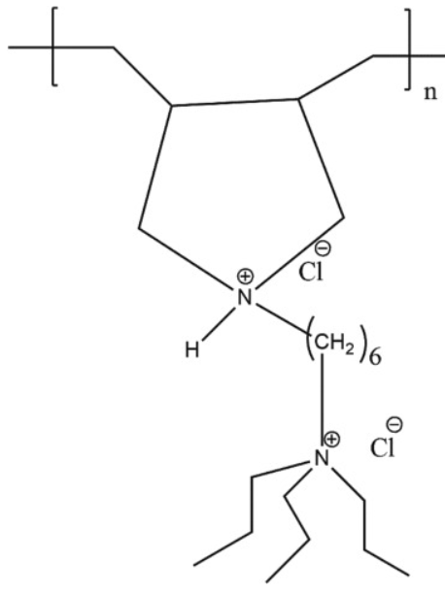
RESEARCH PAPER 2
Aim :
Desalination Plant Acid Cleaning: Corrosion & Inhibition Study
Background :
Elucidating the corrosion characteristics of brine heater and evaporator condenser alloys during acid cleaning of MSF plants and its mitigation. MSF plants suffer from scaling (mineral deposits) on brine heater and evaporator tubes. These scales are removed using acid cleaning, often with 3% HCl at 40 °C for 72 hours. But acid cleaning damages metal components, especially Cu–Ni alloys, unless corrosion inhibitors are used.
Experimental Setup :
Materials studied : CuNi10 (10% nickel), CuNi30 (30% nickel)
New corrosion inhibitor : PDTDC (a nitrogen-containing ionic polymer)
Goal : See if PDTDC can protect these metals under harsh acid cleaning conditions.
Chemical structure of poly (N1, N1-diallyl-N6, N6, N6-tripropylhexane-1,6-diaminium chloride) (PDTDC).

Slide 8
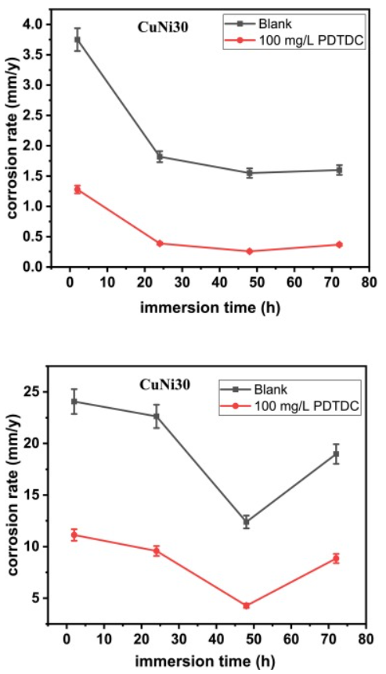
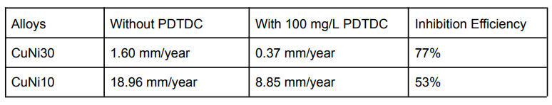
RESEARCH PAPER 2
Results :
1. Corrosion Behavior
Both alloys corrode significantly during acid cleaning. CuNi30 showed better
resistance than CuNi10 due to higher Ni content. Corrosion led to pitting and
surface roughness.
2. Effectiveness of PDTDC
PDTDC adsorbs onto the metal surface, mainly at cathodic sites. It blocks
hydrogen ion (H⁺) reduction, slowing down corrosion. It’s a mixed-type inhibitor,
but cathodic dominant.
3. PDTDC remains effective up to 72 hours and 50 °C, with best results at 48 hours.
4. PDTDC performs well under flow conditions due to improved contact with metal
surfaces.
The variation of corrosion rate (mm/y) with immersion time (h) for the corrosion of CuNi30 and CuNi10 alloys in 3 wt% HCl solution at 30 °C.

Slide 9
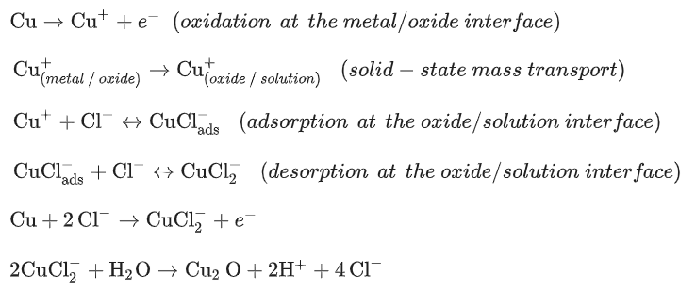
RESEARCH PAPER 2
Conclusion :
PDTDC is a highly effective and stable corrosion inhibitor for acid cleaning in MSF desalination plants, showing superior performance with CuNi30 and reasonable effectiveness with CuNi10. It serves as a cost-efficient and promising alternative to conventional inhibitors and has potential for use in multi-metal corrosion protection formulations. The study holds strong industrial relevance, especially for desalination units, brine heaters, evaporator cleaning, and systems like MSFE that use Cu–Ni alloys in auxiliary or chemical plants.
The variation of corrosion rate (mm/y) with immersion time (h) for the corrosion of CuNi30 and CuNi10 alloys in 3 wt% HCl solution at 30 °C.

Slide 10
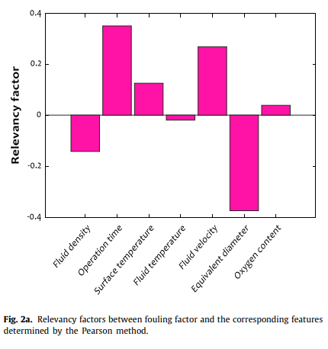
RESEARCH PAPER 3
Novel and robust machine learning approach for estimating the fouling factor in heat exchangers.
Aim :
Develop an accurate, reliable, and generalizable machine learning model to estimate the fouling factor (Rf) in heat exchangers based on operational parameters, in order to improve energy efficiency, reduce maintenance costs, and enable predictive cleaning.
Background :
Fouling in heat exchangers, including MSFE heaters, is the buildup of unwanted materials like scale or corrosion on surfaces, reducing heat transfer efficiency. The fouling factor (Rf) is a key performance metric representing thermal resistance caused by fouling.
Traditionally, Rf is estimated using simplified empirical formulas, but these often fail under dynamic and non-linear industrial conditions. The paper proposes using machine learning for accurate and robust Rf prediction to help industries optimize cleaning schedules and reduce energy loss.
  Positive value: as the feature increases, the fouling factor increases.
  Negative value: as the feature increases, the fouling factor decreases.

Slide 11
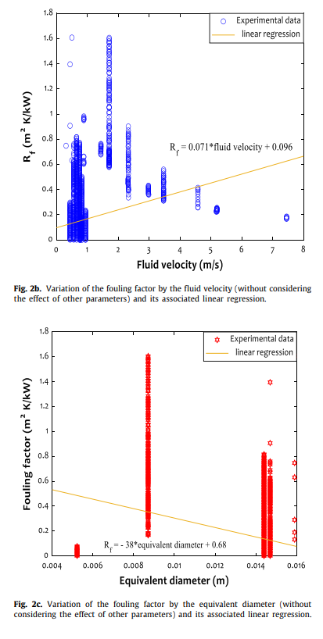
RESEARCH PAPER 3
Training Dataset
  Total samples: 11,626 fouling observations from prior lab work by Davoudi and Vaferi (2018)
  Features used:
    Fluid velocity and density
    Oxygen content
    Surface and fluid temperature
    Operation time
    Pipe/equivalent diameter
    Fluid composition
Methodology Overview
  Preprocessing
    Z-score normalization applied to scale input features
    Non-linear transformation of the fouling factor — √Rf (square root) worked best for prediction

Slide 12
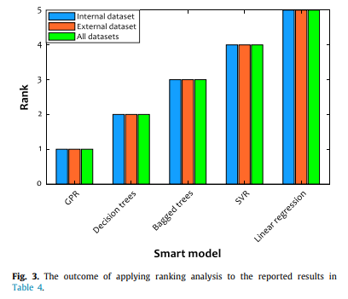
RESEARCH PAPER 3
Methodology Overview
  Preprocessing
    Z-score normalization applied to scale input features
    Non-linear transformation of the fouling factor — √Rf (square root) worked best for prediction
  Model Training
    Used 5-fold cross-validation (80% of data) to tune and validate models. Tested on a completely unseen test set (20% of data)
  Models Evaluated:
    Gaussian Process Regression (GPR) (best performer)
    Decision Trees
    Bagged Trees
    Support Vector Regression (SVR)
    Linear Regression (baseline)
  Evaluation Metrics:
    R² (coefficient of determination)
    MAPE (mean absolute percentage error)
    MAE, MSE, RAE (other error metrics)

Slide 13
RESEARCH PAPER 3
Methodology Overview
  Preprocessing
    Z-score normalization applied to scale input features
    Non-linear transformation of the fouling factor — √Rf (square root) worked best for prediction
  Model Training
    Used 5-fold cross-validation (80% of data) to tune and validate models. Tested on a completely unseen test set (20% of data)
  Models Evaluated:
    Gaussian Process Regression (GPR) (best performer)
    Decision Trees
    Bagged Trees
    Support Vector Regression (SVR)
    Linear Regression (baseline)
  Evaluation Metrics:
    R² (coefficient of determination)
    MAPE (mean absolute percentage error)
    MAE, MSE, RAE (other error metrics)

Slide 14
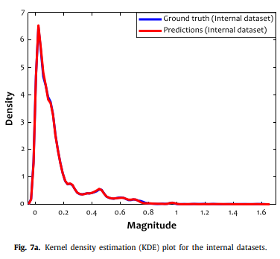
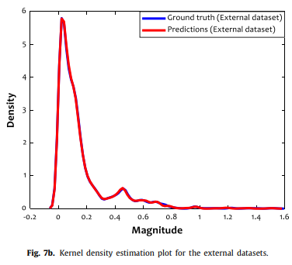
RESEARCH PAPER 3
Real World Applications
  Can be used in:
    Desalination (e.g., MSFE brine heaters)
    Petrochemical and food processing plants
    Power plant heat exchangers
  Helps predict when fouling builds up so cleaning can be scheduled proactively
    Reduces downtime, chemical use, and maintenance costs
Key Innovation
  The paper found that predicting √Rf instead of Rf significantly improved all ML models’ generalization and accuracy.
Conclusion
This paper provides a validated, accurate, and deployable ML model (GPR) for predicting fouling in heat exchangers. It's a strong foundation for the MSFE heater cleaning process, especially proposing predictive maintenance using machine learning.

Slide 15
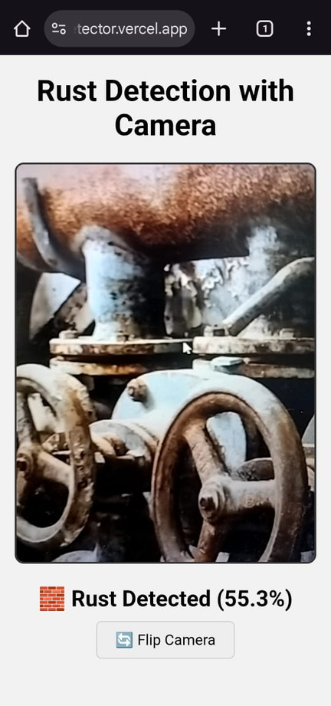
PROTOTYPE
Developed a real-time corrosion detection web application using ReactJS and TensorFlow.js, which leverages a deep learning model trained on image data to detect rust (corrosion) using a mobile or webcam feed. The app accesses the user's camera, classifies live video frames, and displays corrosion status with visual feedback. The prototype is lightweight, browser-based, and mobile-optimized for field-level inspection use.
Features Implemented
  Real-time prediction display (Rust Detected / No Rust)
  Corrosion detection using a pre-trained CNN model
Planned Features
  Pipe detection and classification using object detection models (e.g., SSD or YOLO)
  Diameter estimation using bounding box + pixel-to-mm conversion
  Fouling level prediction using ML regression models (e.g., GPR or LSTM) trained on MSFE operating data
  Image capture and export for maintenance logging or AI model re-training
Protype Preview

Slide 16
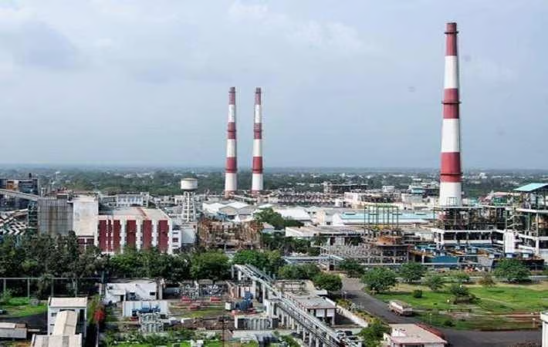
BIBLIOGRAPHY
  https://www.arulrubbers.com/achievements.php
  Kelesoglu, A. et al. (2022) ‘A review on the evolution of induction fluid heaters’, Energy Sources, Part A: Recovery, Utilization, and Environmental Effects, 44(3), pp. 7949–7966. doi: 10.1080/15567036.2022.2118906.
  Moses M. Solomon, Saviour A. Umoren, Nsidibeobong M. Solomon, Bamidele Durodola, Akeem Y. Adesina, Philip Hall, Medinat O. Osundiya, Elucidating the corrosion characteristics of brine heater and evaporator condenser alloys during acid cleaning of MSF plants and its mitigation, Desalination, Volume 569, 2024, 117027, ISSN 0011-9164, https://doi.org/10.1016/j.desal.2023.117027.
  https://www.scribd.com/document/479242988/Fired-Heaters-Cleaning-heater-convection-tub es
  https://github.com/pjsun2012/Phase5_Capstone-Project
  https://github.com/Dev-Satish-02/rust-detector
  https://rust-detector.vercel.app/

Slide 17
THANK YOU

